Slide 1
Installation of Ansible

Slide 2
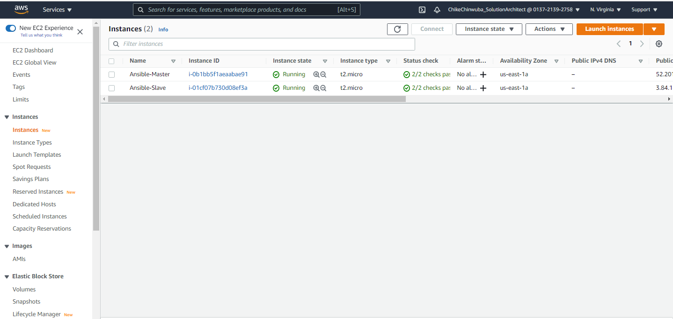
Ansible of Master and Slave Instances

Slide 3
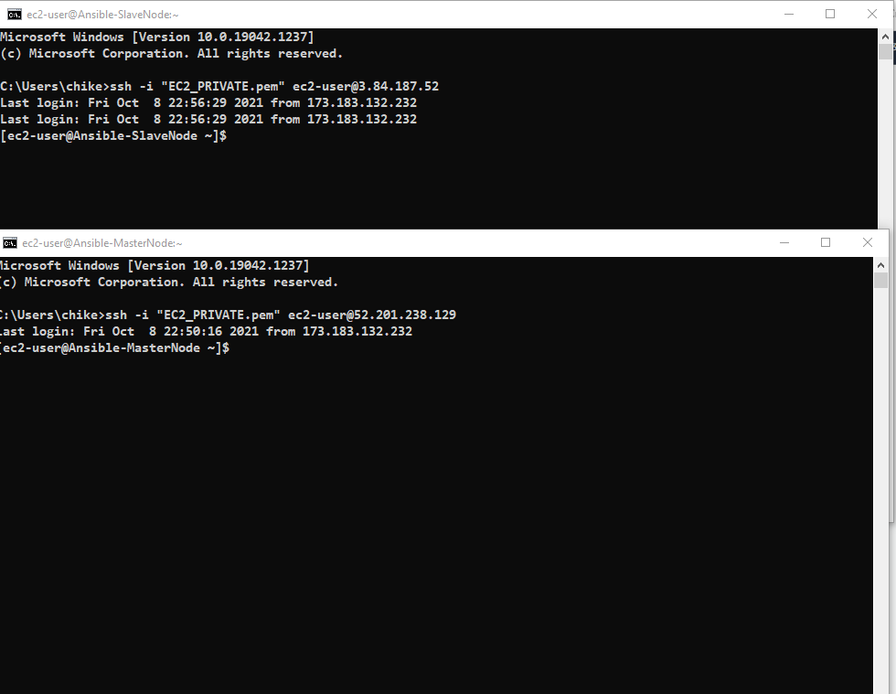
Master and Slave Instances connected

Slide 4
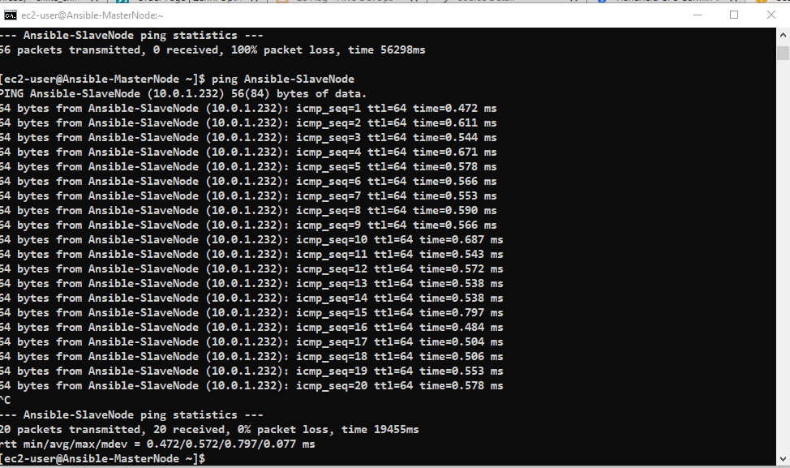
Master and Slave Instances ping

Slide 5
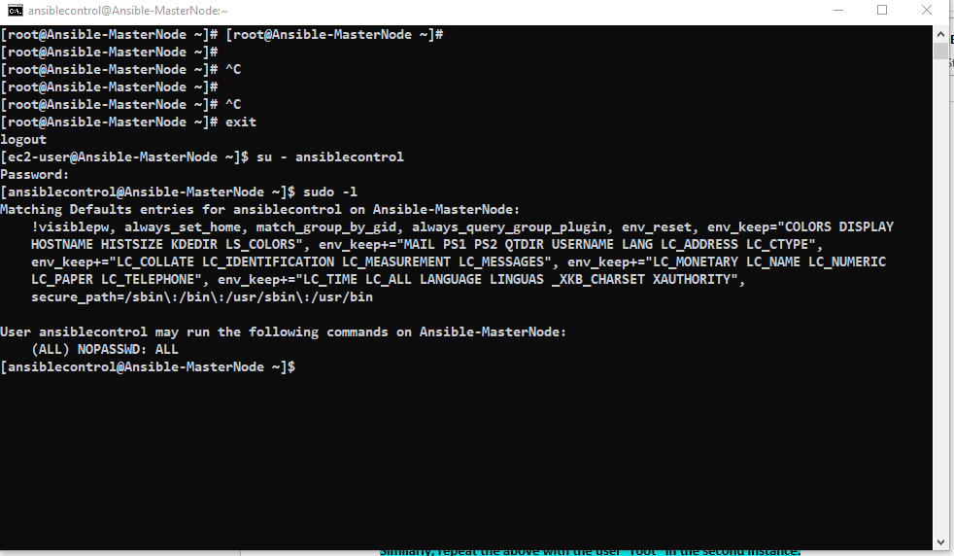
Master Passwordless Authentication

Slide 6
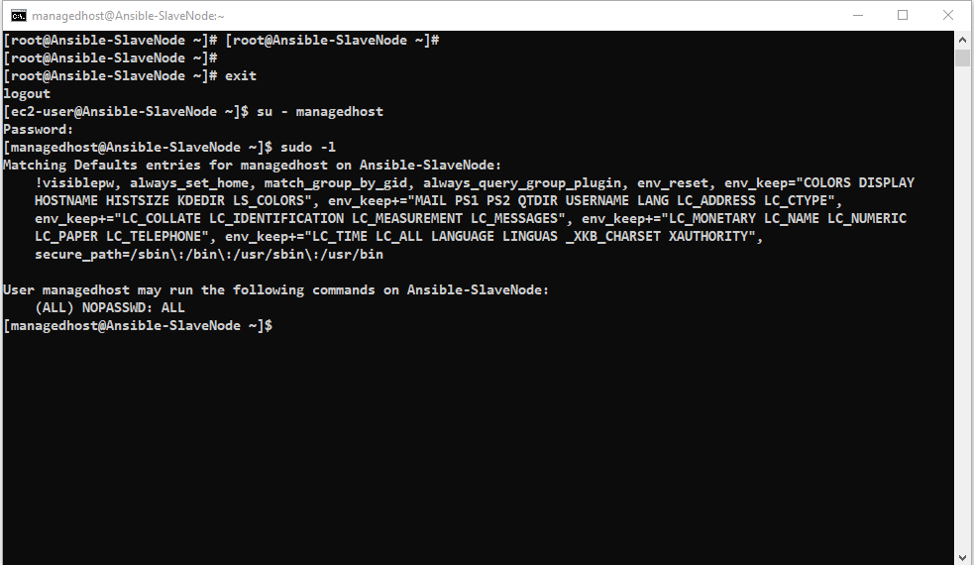
Slave Passwordless Authentication

Slide 7
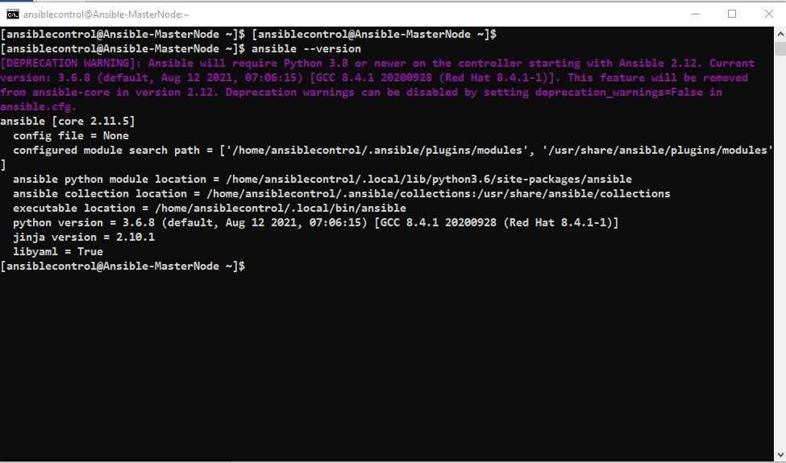
Ansible Version

Slide 8
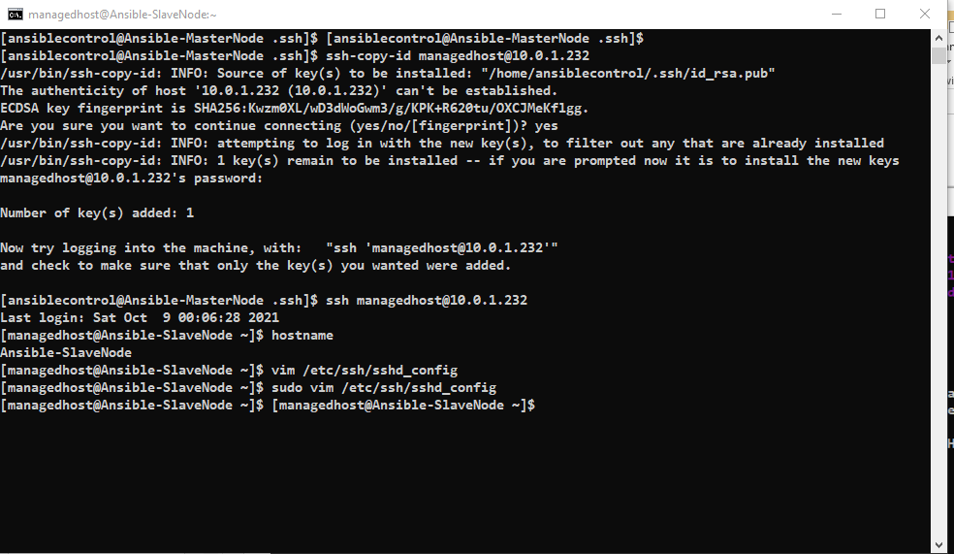
ssh –copy-id managedhost@10.0.1.232

Slide 9
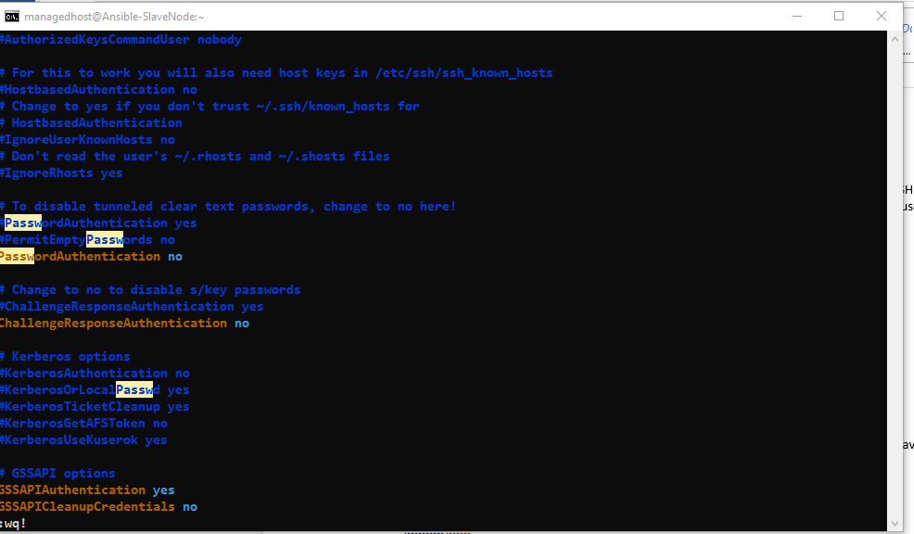
PasswordAuthentication - NO

Slide 10
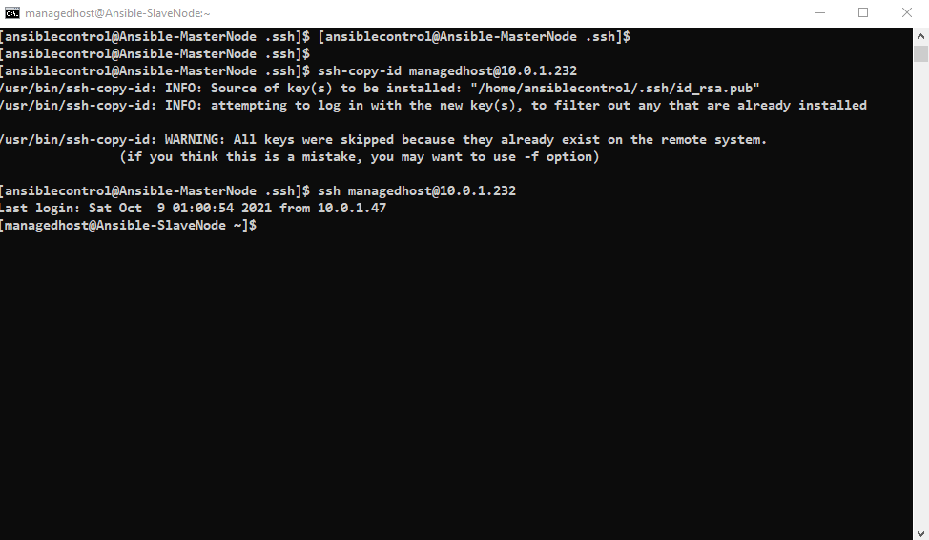
Login to Slave without password

Slide 11
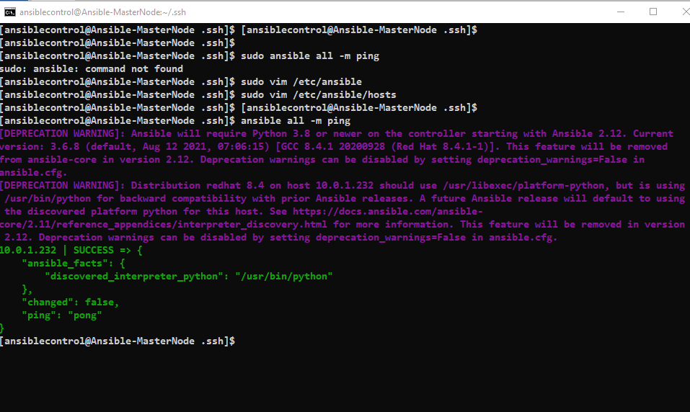
ansible –m ping

Slide 12
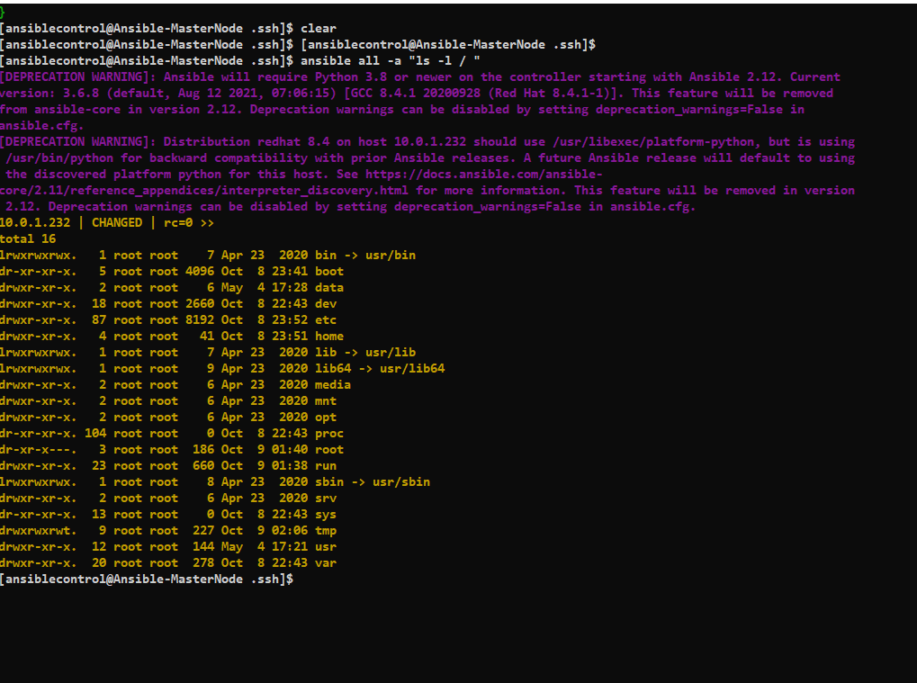
ansible all –a “ls –l”

Slide 13
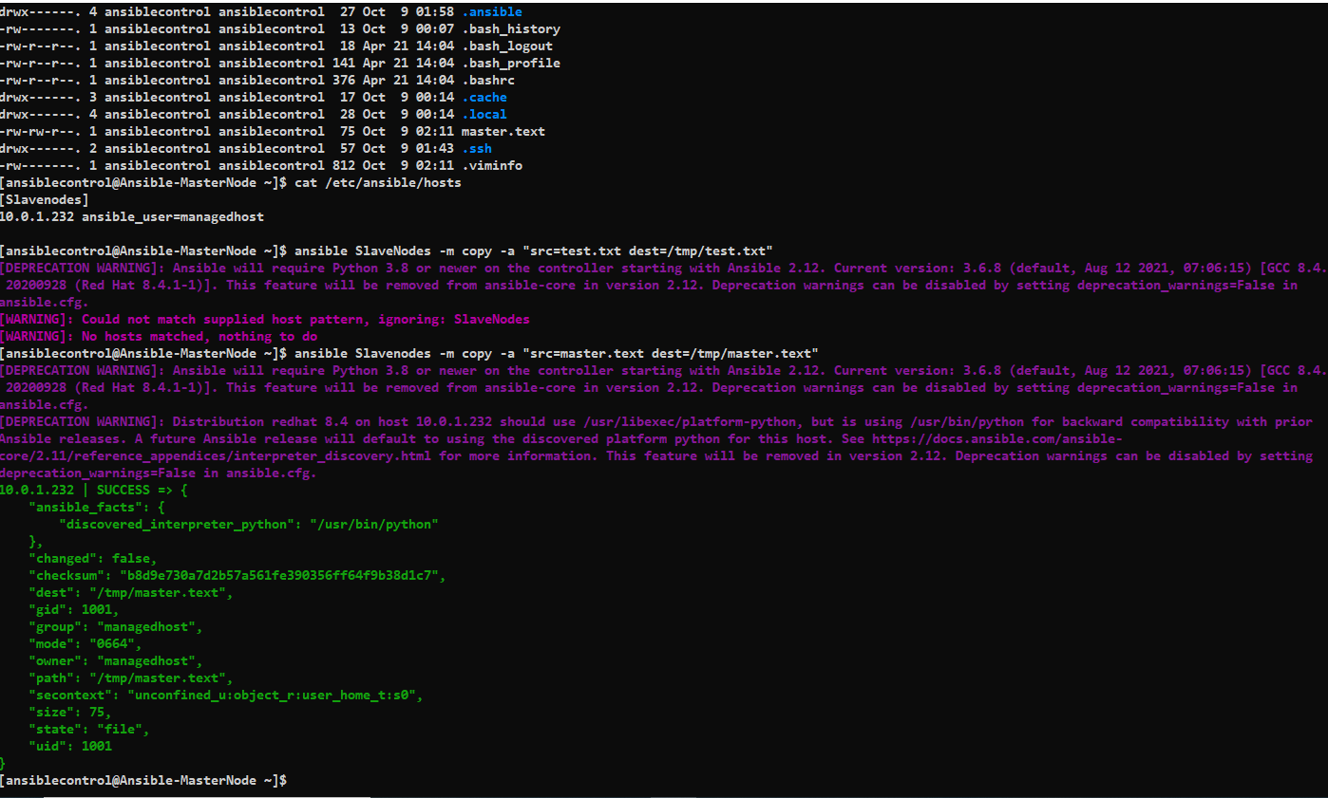
Verification – Managed hosts

